Slide 1
Spatial Filtering

Slide 2
Smoothing Filters: Linear spatial filter-average filter
h=fspecial('average',3);
cat=imread('peppers.png');
results1=imfilter(cat,h);
results2=imfilter(cat,h,'replicate');
results3=imfilter(cat,h,'circular');
results4=imfilter(cat,h,'symmetric');
subplot(3,3,1),imshow(cat),title('original image');
subplot(3,3,2),imshow(results1),title('zero padding');
subplot(3,3,3),imshow(results2),title('replicate');
subplot(3,3,4),imshow(results3),title('circular');
subplot(3,3,5),imshow(results4),title('symmetric');

Slide 3
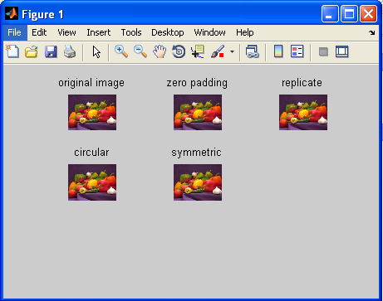

Slide 4
Smoothing Filters: non-Linear spatial filter- median, min, max
cat=imread('lena.tiff');
nois=imnoise(cat,'salt & pepper');
g=ordfilt2(nois,5,ones(3,3));
g1=ordfilt2(nois,1,ones(3,3));
g2=ordfilt2(nois,9,ones(3,3));
subplot(2,3,1),imshow(cat),title('original image');
subplot(2,3,2),imshow(nois),title('salt & pepper noise image');
subplot(2,3,3),imshow(g),title('median filter');
subplot(2,3,4),imshow(g1),title('min filter');
subplot(2,3,5),imshow(g2),title('max filter');

Slide 5
Sharpening Filters: Unsharp Masking
I = imread('cameraman.tif');
subplot(3,3,1),imshow(I); title('Original Image');
H = fspecial('laplacian');
sharpened = imfilter(I,H,'replicate');
subplot(3,3,3),imshow(sharpened),title('laplacian');

Slide 6
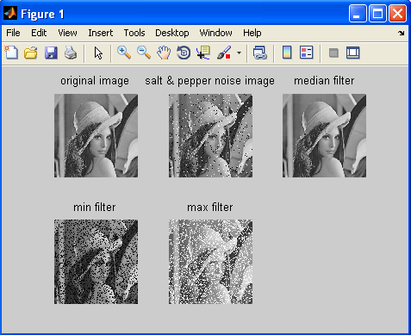

Slide 7
H = fspecial('sobel');
sharpened1 = imfilter(I,H,'replicate');
subplot(3,3,4),imshow(sharpened1),title('sobel');
H = fspecial('unsharp');
sharpened2 = imfilter(I,H,'replicate');
subplot(3,3,5),imshow(sharpened2),title('unsharp');
H = fspecial('prewitt');
sharpened3 = imfilter(I,H,'replicate');
subplot(3,3,6),imshow(sharpened3),title('prewitt') ;

Slide 8
